Slide 1
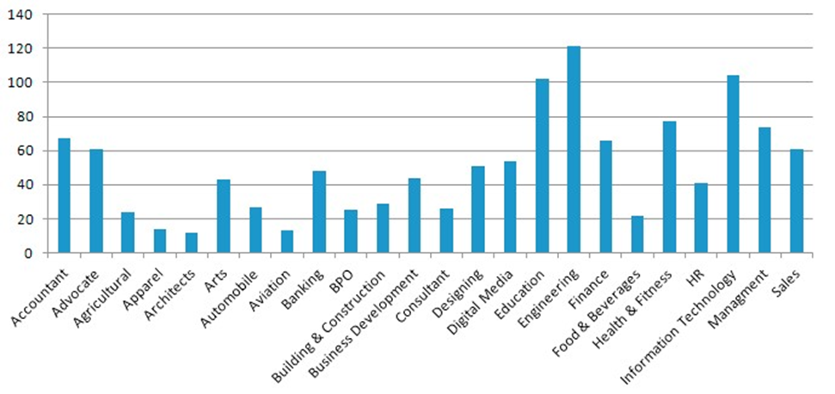
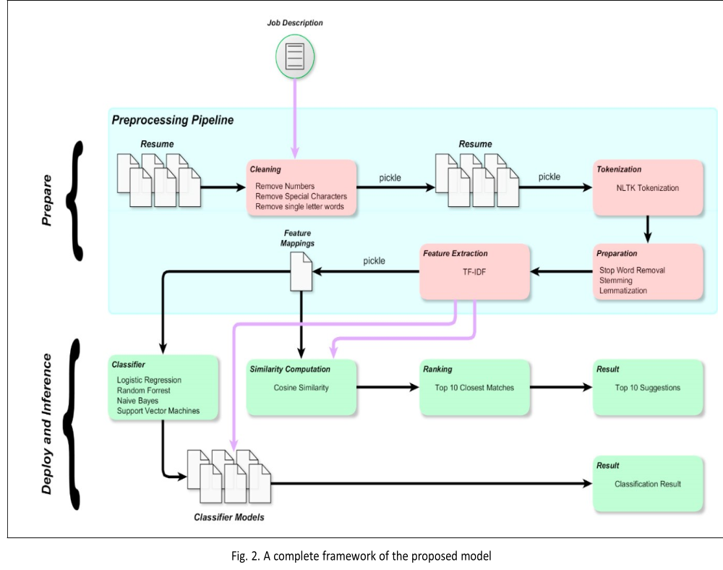
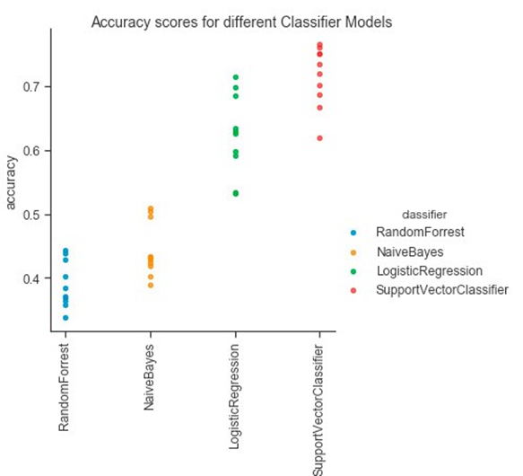
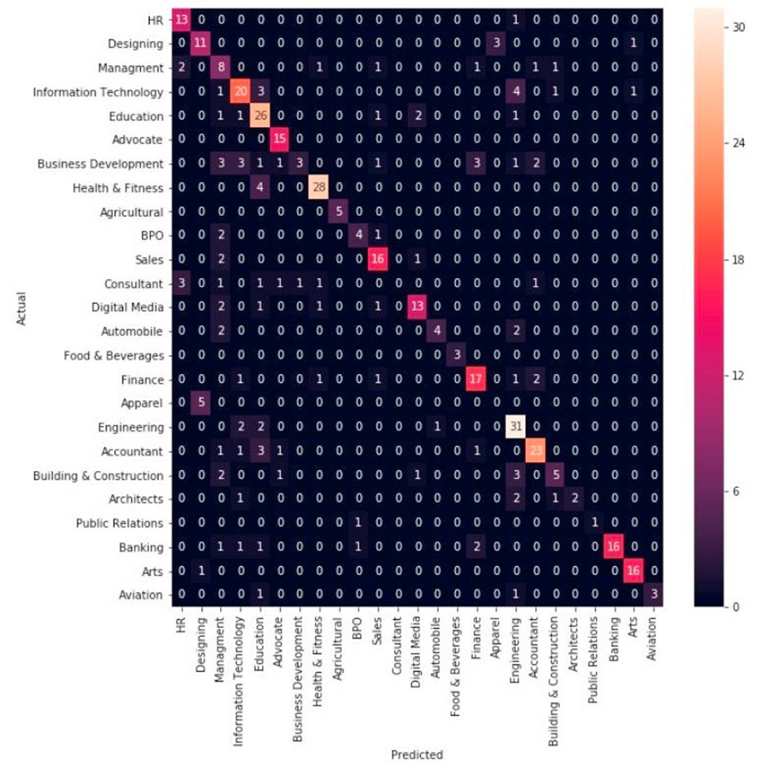
Resume scanning using python
Panil jain¹, Nandkishor kamble², Risha Nadar³, Shaikh Luqman⁴
ABSTRACT
INTRODUCTION
RESULTS
DISCUSSION
Finding suitable candidates for an open role could be a daunting task, especially when there are many applicants. It can impede Team progress for getting the right person on the right time. An automated way of “Resume Classification and Matching” could Really ease the tedious process of fair screening and shortlisting, it would certainly expedite the candidate selection and decisionmaking process. This system could work with a large number of resumes for first classifying the right categories using different Classifier, once classification has been done then as per the job description, top candidates could be ranked using Content-based Recommendation, using cosine similarity and by using k-NN to identify the CVs that are nearest to the provided job description.
Talent acquisition is an important, complex, and timeconsuming function within Human Resources The Sheer scale of Indias market is overwhelming . Not only is there a staggering one million people coming Into the job market every month, but there is also huge turnover. As per LinkedIn, India has the highest percentage of The workforce that is “actively seeking a new job”. Clearly, this is an extremely liquid, massive marketŁbut one That also has many frustrating inefficiencies. The most challenging part is the lack of a standard structure and format For resume which makes short listing of desired profiles for required roles very tedious and time-consuming Effective screening of resumes requires domain knowledge, to be able to understand the relevance and applicability Of a profile for the job role.
For resume which makes short listing of desired profiles for required roles very tedious and time-consuming Effective screening of resumes requires domain knowledge, to be able to understand the relevance and applicability Of a profile for the job role. With a huge number of different job roles existing today along with the typically large .
Number of applications received, short-listing poses a challenge for the human resource department. Which is only further worsened by the lack of diverse skill and domain knowledge within the HR department, required for effective .
Two models have been built on the cleansed data: i) Classification - Based on the resume and category the model has been designed to categories the resume in the right category and ii) Recommendation -The model would create a summary of the resume and job description provided by the recruiter and give the list of most relevant resume based on the similarity between resume and jobs description
Today the major problem being faced across the industry is how to acquire the right talent, using minimal resources over the internet and in minimal time. As described in section 1, there are three major challenges that are required to be overcome, to bring efficiencies to the complete process.
••• Separating the right candidates from the packMaking sense of candidate CVsKnowing that candidates can do the job before you hire them
Our group intends to provide a solution to the above-mentioned challenges by automating the process. The solution would help to find the right CV from the large dumps of CVs; would be agnostic to the format in which CV has been created and would give with the list of CVs which are the best match to the job description provided by the recruiter [11]. The proposed solution involves supervised learning to classify the resumes into various categories corresponding to the various domains of expertise of the candidates. A multi-pronged approach to classification is proposed as follows:
••• Perform NER, NLP, and Text classification using n-grams.Use distance-metric based classification.The solution shall provide a feedback loop closure to adjustcorresponding to the incorrectly screened profiles. /improve the accuracy by incorporating the feedback
CONCLUSIONS
Figure 1. Distribution over the different domains
Figure 2. . A complete framework of the proposed model
Huge number of applications received by the organization for every job post. Finding the relevant candidate’s application from the pool of resumes is a tedious task for any organization nowadays. If an Industry provides a large number of resume, then Industry specific model can be developed by utilizing the proposed approach. By involving the domain experts like HR professional would help to build a more accurate model, feedback of the HR professional helps to improve The model iteratively.
METHODS AND MATERIALS
ClickThe aim of this work is to find the right candidates resume from the pool of resumes. To achieve this objective, we have developed a machine learning based solution, The complete framework for the proposed model is shown in Figure 2. The proposed model worked in mainly in two steps: i) Prepare and ii) Deploy and Inference.
Dataset Description: The data was downloaded from the online portal(s) and from Kaggle. The data is in Excel format, with three column ID, Category, and Resume. ID - The sequence number of the resume, Category - Industry sector to which the resume belongs to, and Resume - The complete CV of the candidate. The number of instances for the different domain can be seen from Figure 1.
REFERENCES
1.Swapnil Sonar, Resume Parsing with Named Entity Clustering Algorithm, IEEE Research, may2012, http://www.slideshare.net/swapnilmsonar/resu me-parsing-with-named-entity-clusteringalgorithm
2.Machine Learning Methods for Solving Complex
Ranking and Sorting Issues in
HumanResourcing”, Institute of Electrical and Electronics Engineers (IEEE) 2017.
3.IntelligentHiringwithResumeParserandRankingus ingNaturalLanguageProcessingandMachine Learning”, International Journal of Innovative Research in Computer and Communication
Engineering(IJIRCCE)
CONTACT
Figure 3. A complete framework of the proposed model
Figure 4 . . Confusion matrix using Linear SVC classifier
<your name>
<organization name>
Email:
Phone:
Website:

